Slide 1

ONLINE GROCERY SHOP

Slide 2
Malla Reddy Engineering College for Women
Presented By:
K.Prasanna Rao

Slide 3
DEVELOPERS
Kesari Prasanna Rao

Slide 4
ABSTRACT
This project is aimed at developing a Web application that depicts online Shopping of grocery products. It integrates the benefits of an ordering products with the convenience of an online excitement and going with the technology, minus the commuting hazards and expenses. It will usher in the immense flexibility and sophistication in the existing manual platform structures, with the perfect blend of synchronous and asynchronous interaction. It provides a means of collaborative E-ordering for the customers.

Slide 5
MODULES
Customer module
View Products
Product Booking
Give Feedback
View Product Bookings

Slide 6
MODULES
Administrative module
Manage Products
Manage Booking
Manage Customers
Manage Feedback

Slide 7
Administrative module
Administrative module is provided for the sake of administrators to manage the site and update the content at regular intervals, The major operations included in this module are:
Create and maintain product categories.
View the product available.
Update product information.
Remove the product.
View Customer information and Bookings.

Slide 8
Customer module
This module is meant for customers, where a user logging into his/her owns account will view this panel. The major operations included in this module were
View all available products and its price , description and other details etc.
View Our Booking.
View and cancelling of the product booking.
Send feedback

Slide 9
3. SCOPE & PURPOSE
3.1 PURPOSE:
To manage the online grocery product ordering. It helps to customer to book products from anywhere. Also make payment on delivery. It helps to people to book desired products at their prefer time.

Slide 10
SCOPE:
The project has a wide scope, as it is not intended to a particular organization. This project is going to develop generic software, which can be applied by any businesses organization. More over it provides facility to its customer. Also the software is going to provide a huge amount of summary data.

Slide 11
PROPOSED SYSTEM:
The Proposed system ensures the complete freedom for users, where user at his own system can logon to this website and can book his product. Our proposed system allows only registered users to book the product, view booking and cancel their booking as per their need.
In this Proposal the entire work is done on online. Here customer can send their queries and suggestions through a feedback form.

Slide 12
Software Used :
PYTHON INTERPRETER
PYCHARM IDE
DJANGO FRAMEWORK
Chrome or Any Other Browser

Slide 13
FrontEnd :
HTML(Hypertext Markup Language)
CSS(Cascading StyleSheet)
Bootstrap(Library of HTML,CSS and JS)

Slide 14
BackEnd :
PYTHON DJANGO
MYSQL(DATABASE)

Slide 15
SYSTEM DESIGN
Unified Modeling Language:
UML stands for Unified Modeling Language. It is a third generation method for specifying, visualizing and documenting the artifacts of an object oriented system under development. Object modeling is the process by which the logical objects in the real world (problem space) are represented (mapped) by the actual objects in the program (logical or a mini world). This visual representation of the objects, their relationships and their structures is for the ease of understanding. This is a step while developing any product after analysis.

Slide 16
The Unified Modeling Language encompasses a number of models.
Use case diagrams
Class diagrams
Sequence diagrams

Slide 17
Use Case Diagram:
Use case diagram consists of use cases and actors and shows the interaction between them. The key points are:
The main purpose is to show the interaction between the use cases and the actor.
To represent the system requirement from user’s perspective.
The use cases are the functions that are to be performed in the module.
An actor could be the end-user of the system or an external system.

Slide 18
Manage Products
Manage Feedback
Manage Booking
Manage Users
Use Case Diagram between ADMIN and SYSTEM:

Slide 19
Booking
Cancel
Search
Feedback
Use Case Diagram between USER and SYSTEM:

Slide 20
Sequence Diagram:
The purpose of sequence diagram is to show the flow of functionality through a use case. In other words, we call it a mapping process in terms of data transfers from the actor through the corresponding objects.

Slide 21
SEQUENCE DIAGRAM

Slide 22
Login
Application
Database
Login
:Request
:Validate()
:executeQuery()
Response
Show Result
Failed:show()

Slide 23
Login
Application
Database
Login
:Request
:Validate()
:executeQuery()
Response
Show Result

Slide 24
DATA FLOW DIAGRAM

Slide 25
Level 0 - DFD
System
Database
Input Output
Level1
Admin/User
Enter the site
Authenticate User
Check whether Admin or customer
Display errors
Customer
Admin
View product
Buy product
Check products
Verify customer
Products
Customer details

Slide 26
ER DIAGRAM

Slide 27
ProID
DOJ
LoginID
ProName
Password
Product
Request
Member
ProComp
MName
ProCat
Price
dob
PhoneNo
Place Order
User Name
Password
OrdNo
Check the Login ID
Login
Order Detail
LoginID
Qty
Proid
Reg. New Member
Name
Address
Password
Registration
City
EMail
State
Phone
Pin code
Country

Slide 28
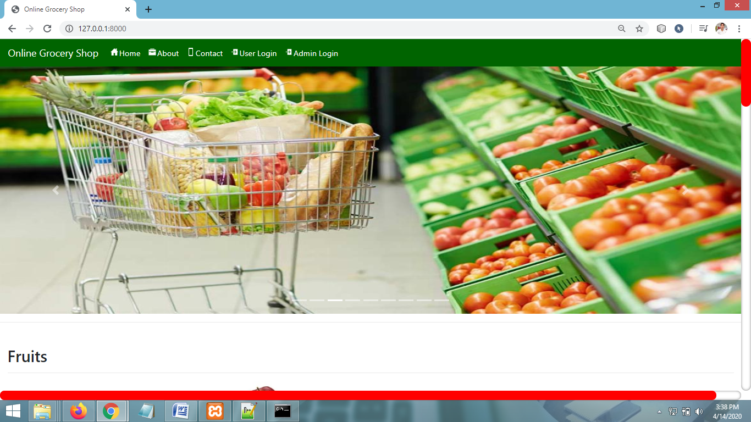
SCREEN SHOTS - HOME PAGE

Slide 29
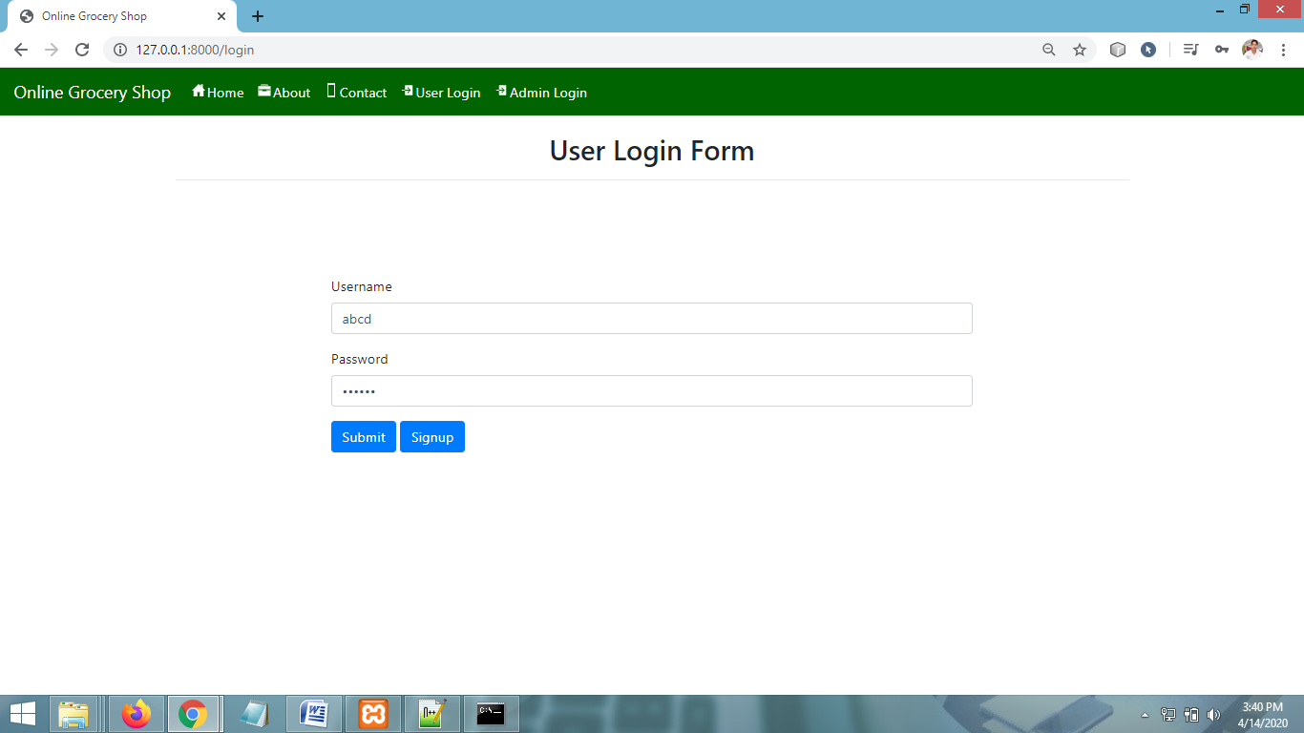
USER LOGIN PAGE

Slide 30
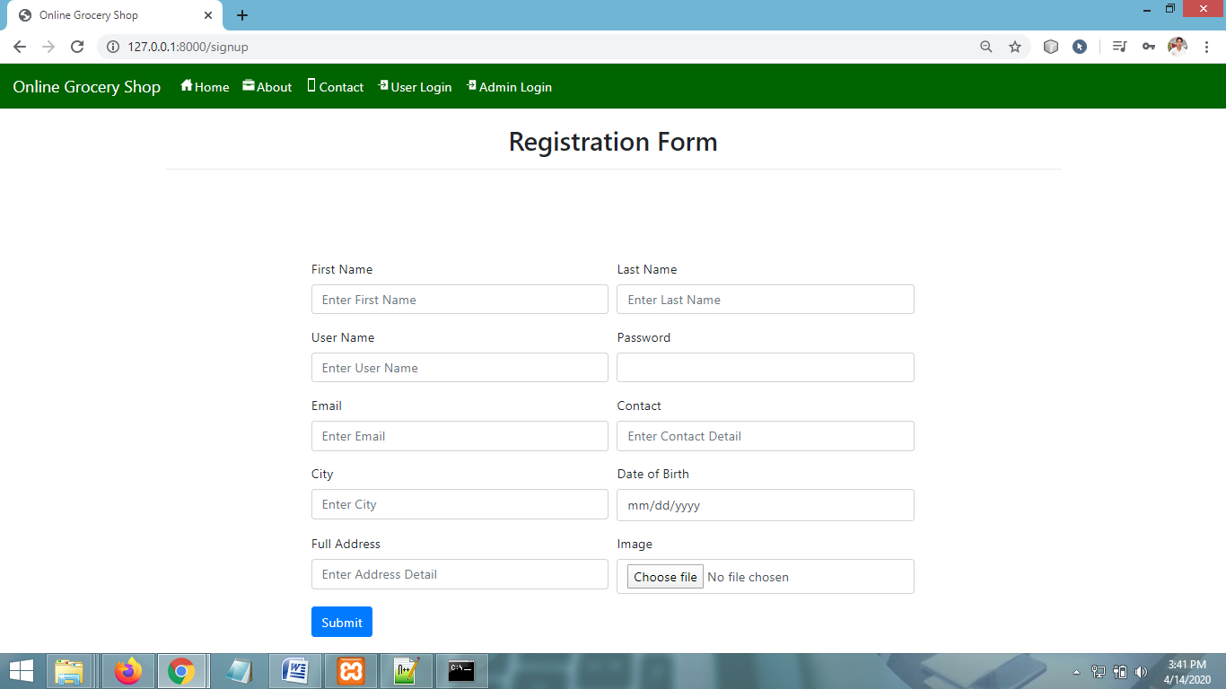
USER SIGNUP PAGE

Slide 31
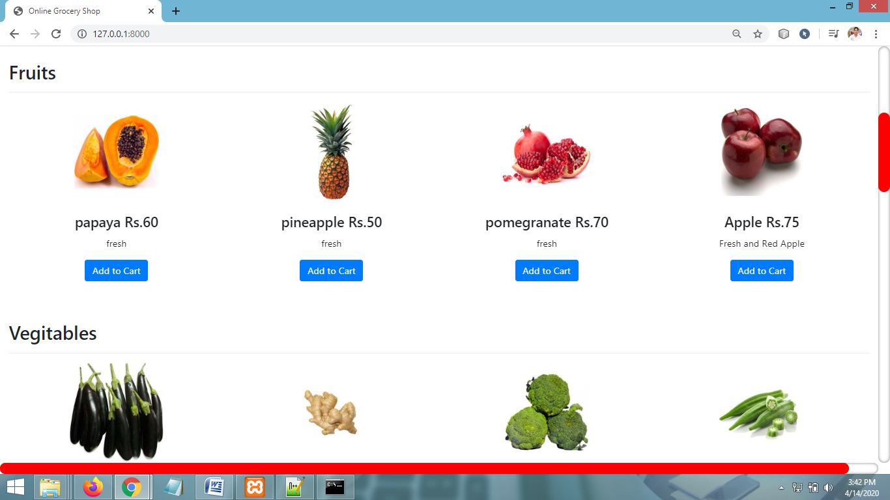
PRODUCT CATEGORIES PAGE

Slide 32
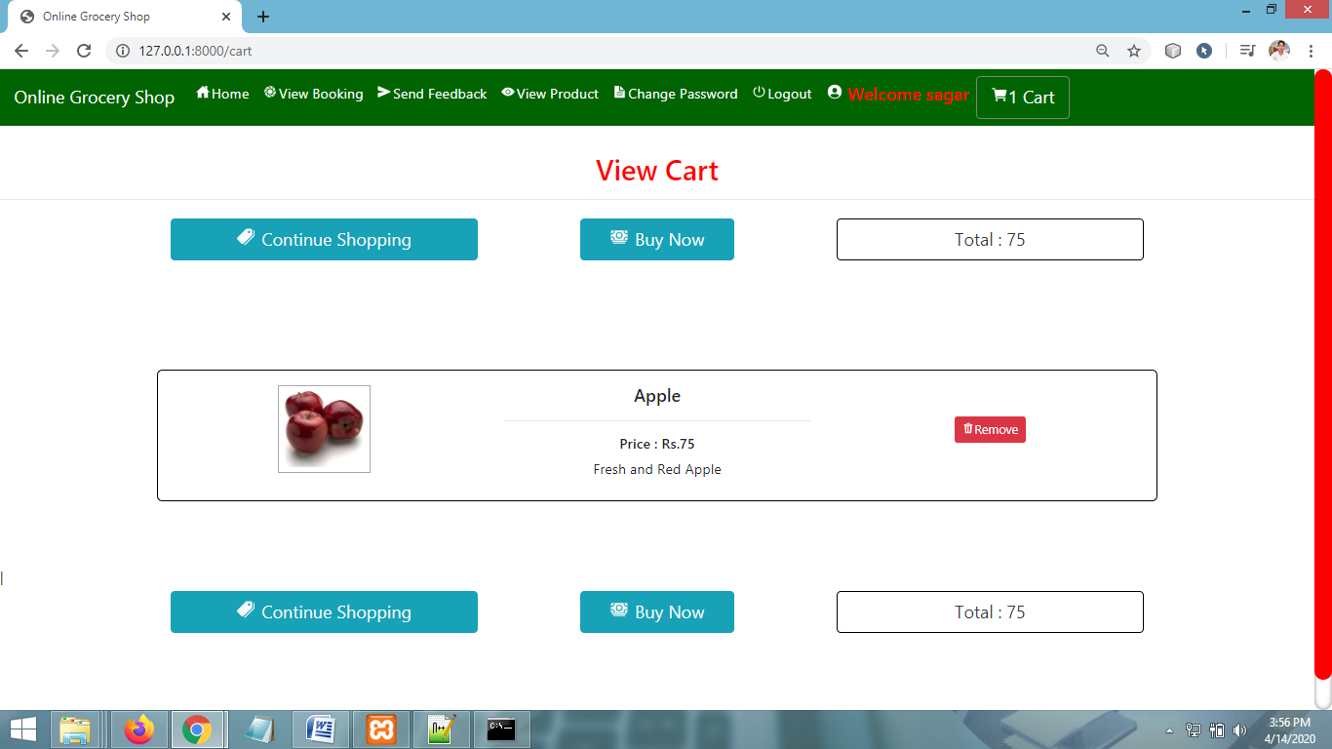
VIEW CART PAGE

Slide 33
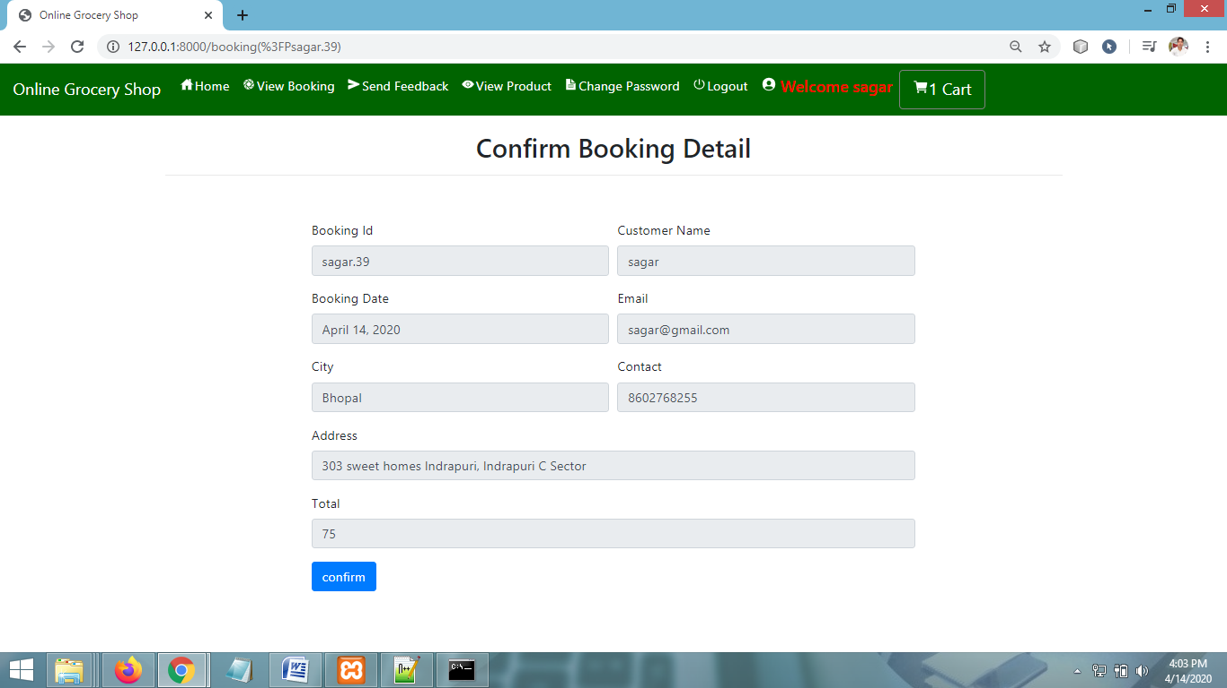
CONFIRM BOOKING PAGE

Slide 34
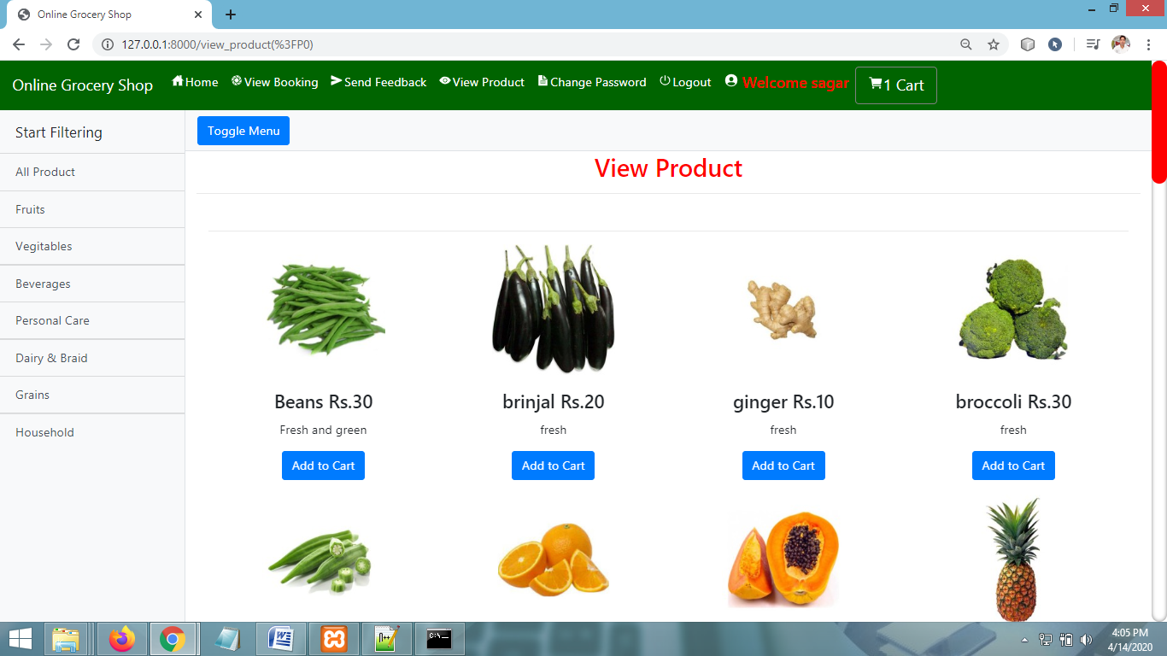
VIEW PRODUCTS PAGE

Slide 35
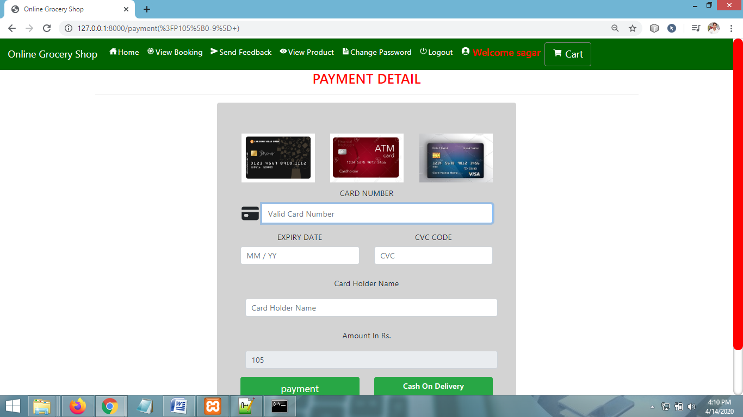
PAYMENT PAGE

Slide 36
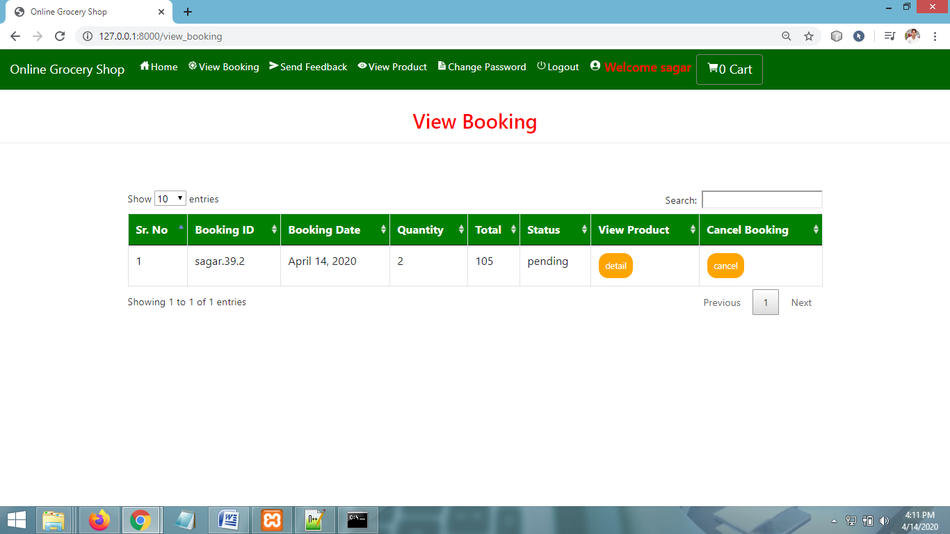
VIEW BOOKING PAGE

Slide 37
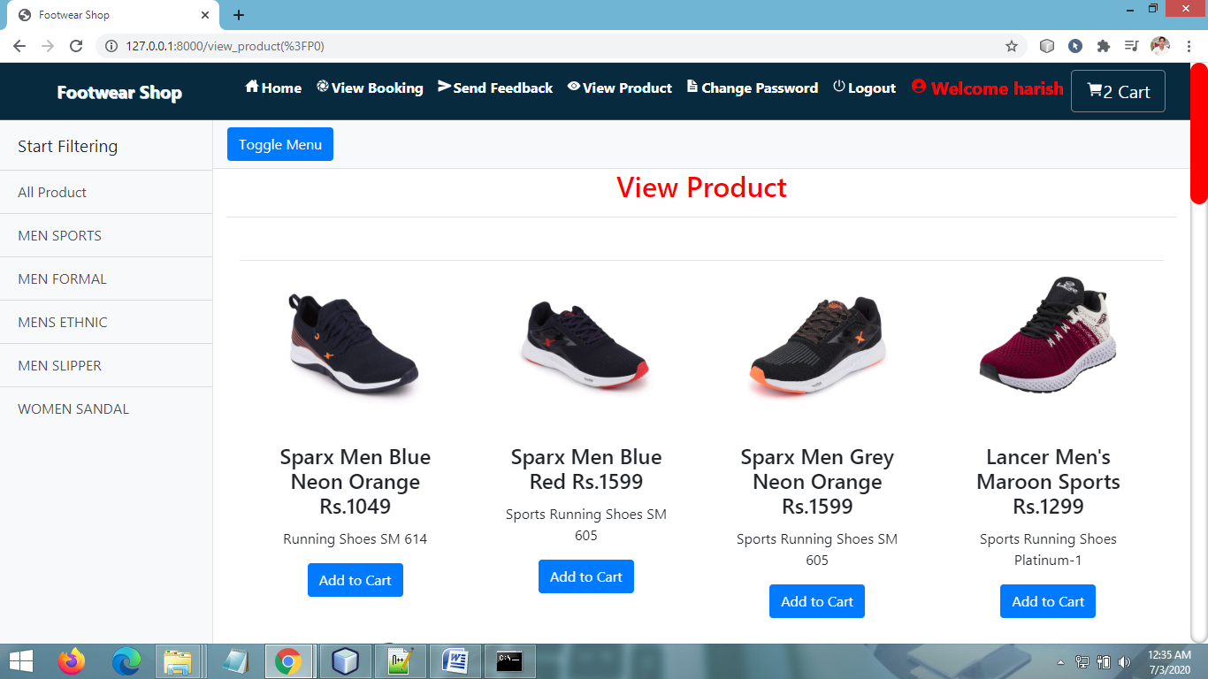
VIEW PRODUCTS PAGE - USER

Slide 38
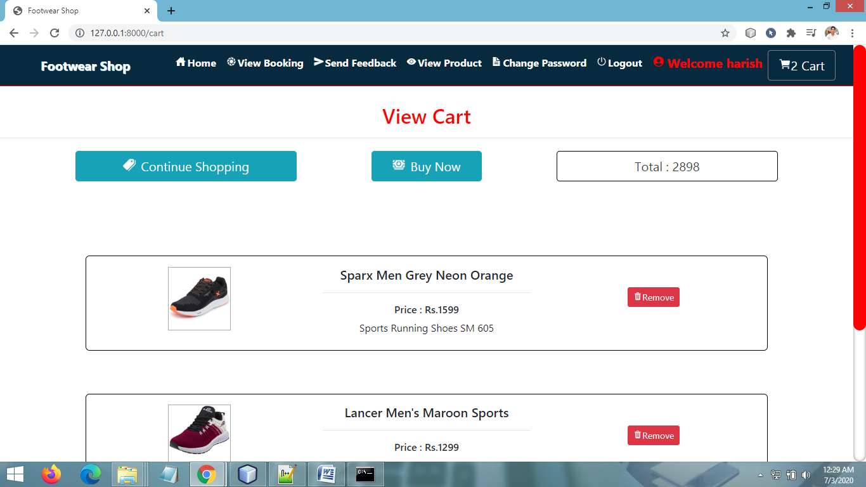
VIEW CART PAGE

Slide 39
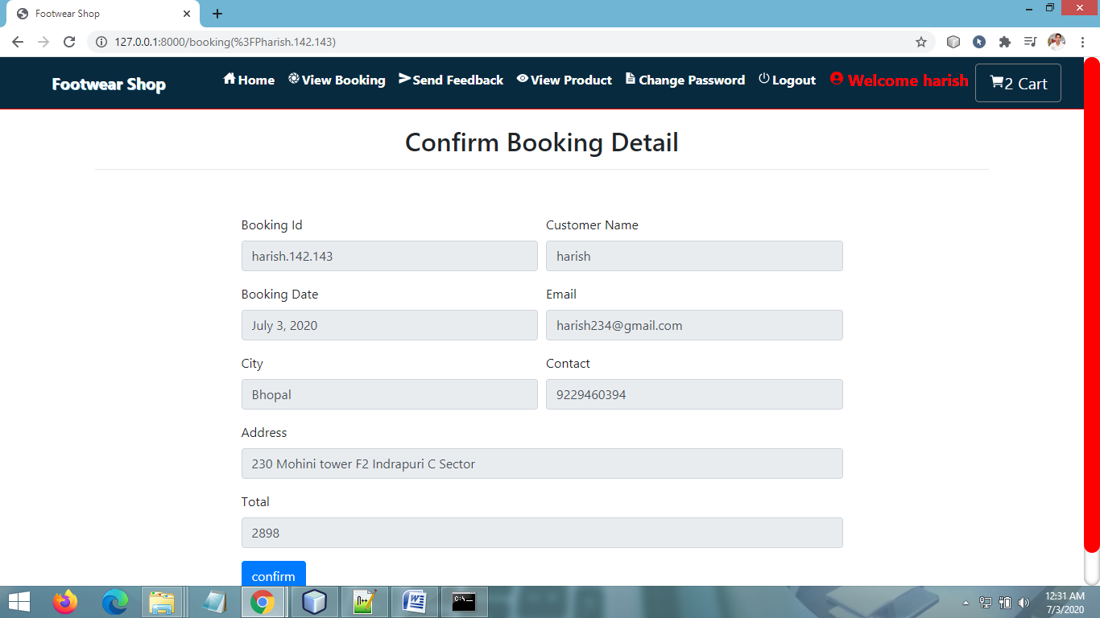
BOOKING PAGE

Slide 40
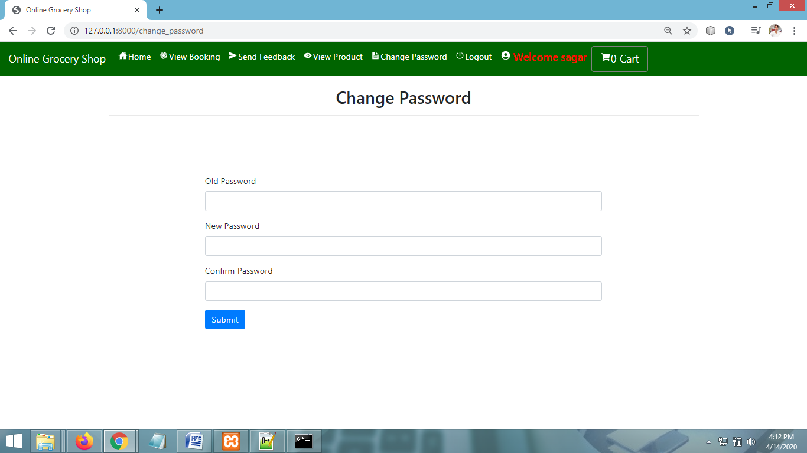
CHANGE PASSWORD PAGE

Slide 41
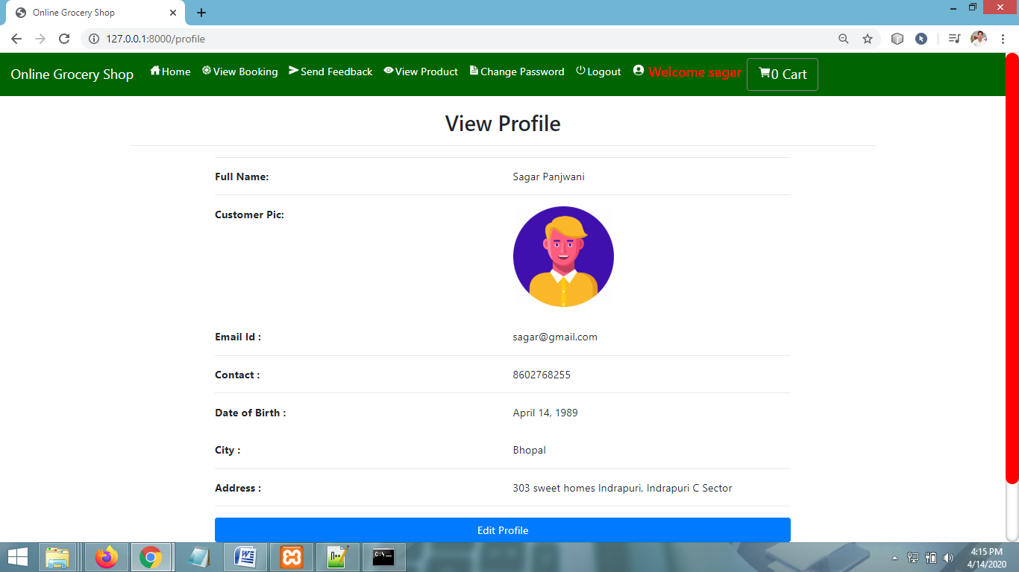
VIEW PROFILE PAGE

Slide 42
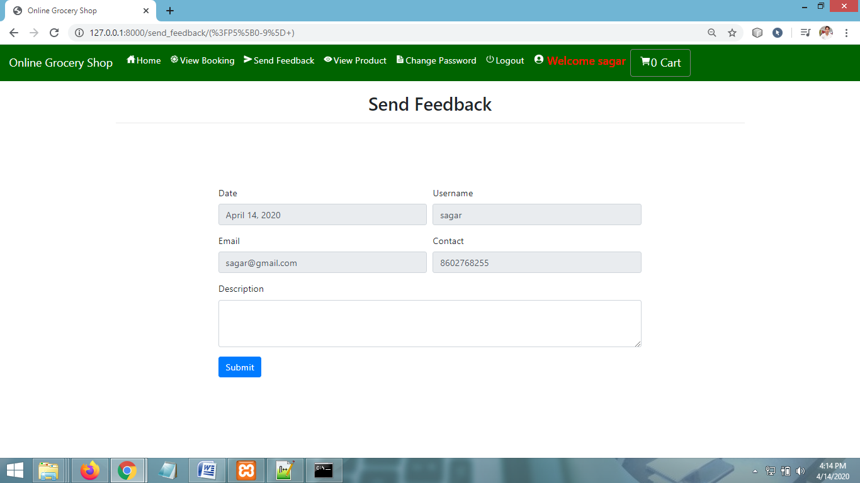
SEND FEEDBACK PAGE

Slide 43
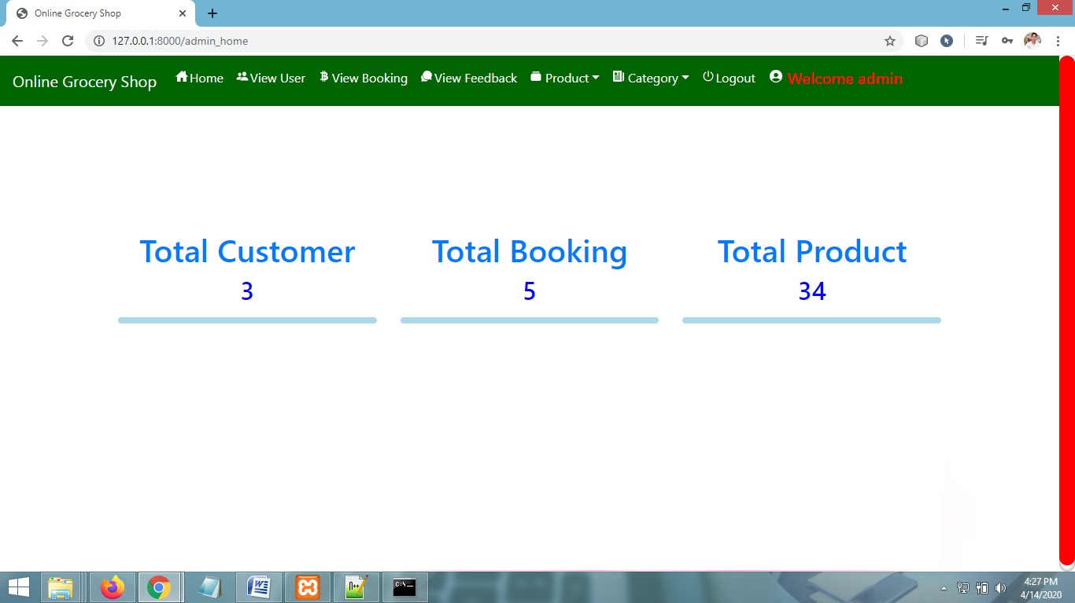
ADMIN HOME PAGE

Slide 44
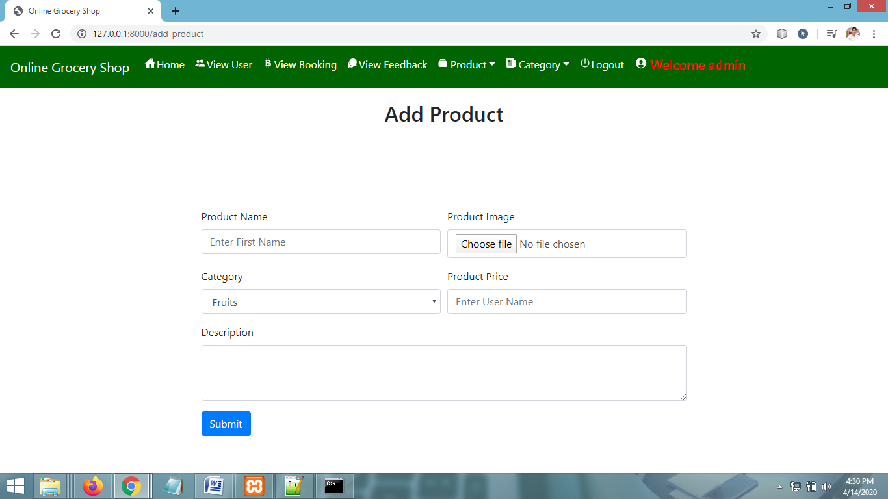
ADD PRODUCT PAGE

Slide 45
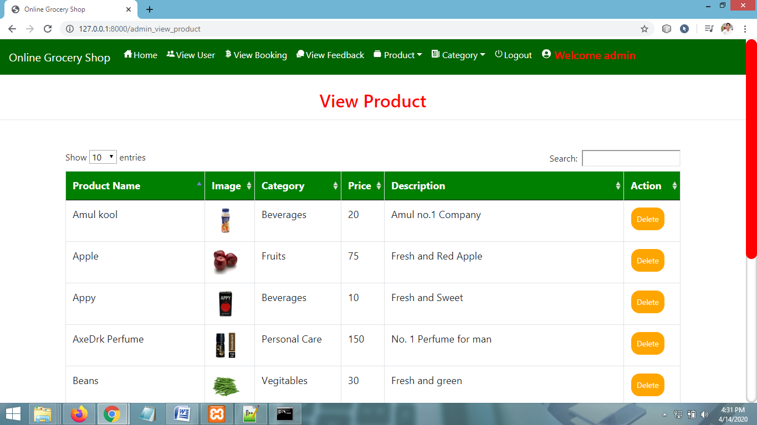
VIEW PRODUCT PAGE

Slide 46
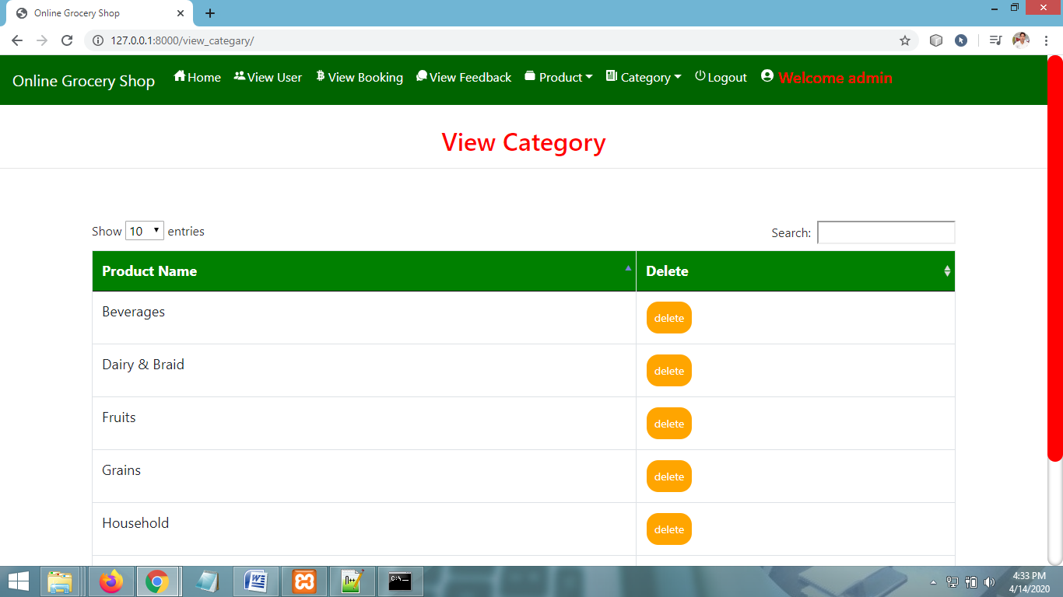
VIEW CATEGORY PAGE

Slide 47
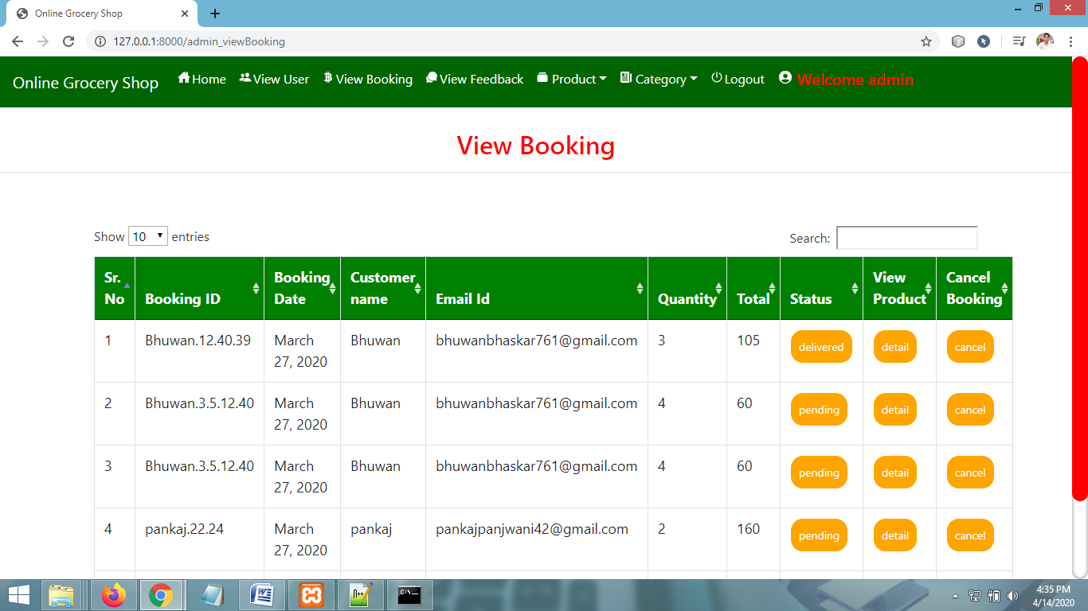
VIEW BOOKING PAGE

Slide 48
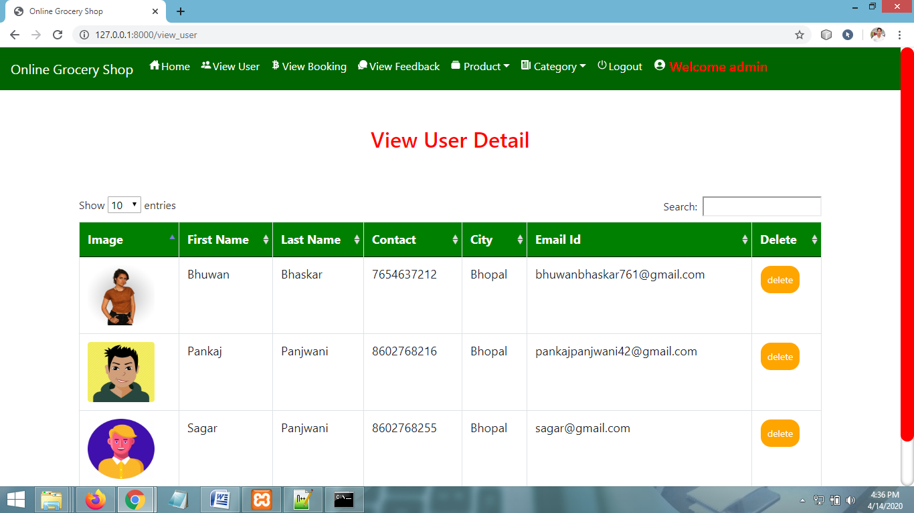
VIEW USERS PAGE

Slide 49
CONCLUSION & FUTURE SCOPE
FUTURE SCOPE
This web application involves almost all the features of the online shopping. The future implementation will be online help for the customers and chatting with website administrator.
CONCLUSION
The project entitled “Online Grocery Shop” is developed using HTML , CSS and Bootstrap as front end and Python , Sqlite database in back end to computerize the process of online shopping. This project covers only the basic features required.

Slide 50
THANKYOU

